Slide 1
LIFE748 – Practical bioinformatics Low-throughput protein annotation with structural bioinformatics
Daniel Rigden
drigden@liv.ac.uk

Slide 2
Overall Plan
Why protein models inform function annotation
Alphafold reminder
Simple structure to function
Predicting protein interactions/complex structure
Advanced AF2 eg multiple conformations
Deep Learning-based annotation methods

Slide 3
Why model proteins?
We want to understand their function better
Function depends more directly on the 3D structure than the sequence
We can use structure-based function prediction methods as well as sequence information
We can sometimes make novel predictions (BLAST will never predict novel functions!)

Slide 4
Quick reminder on AlphaFold 2 and interpreting its models

Slide 5
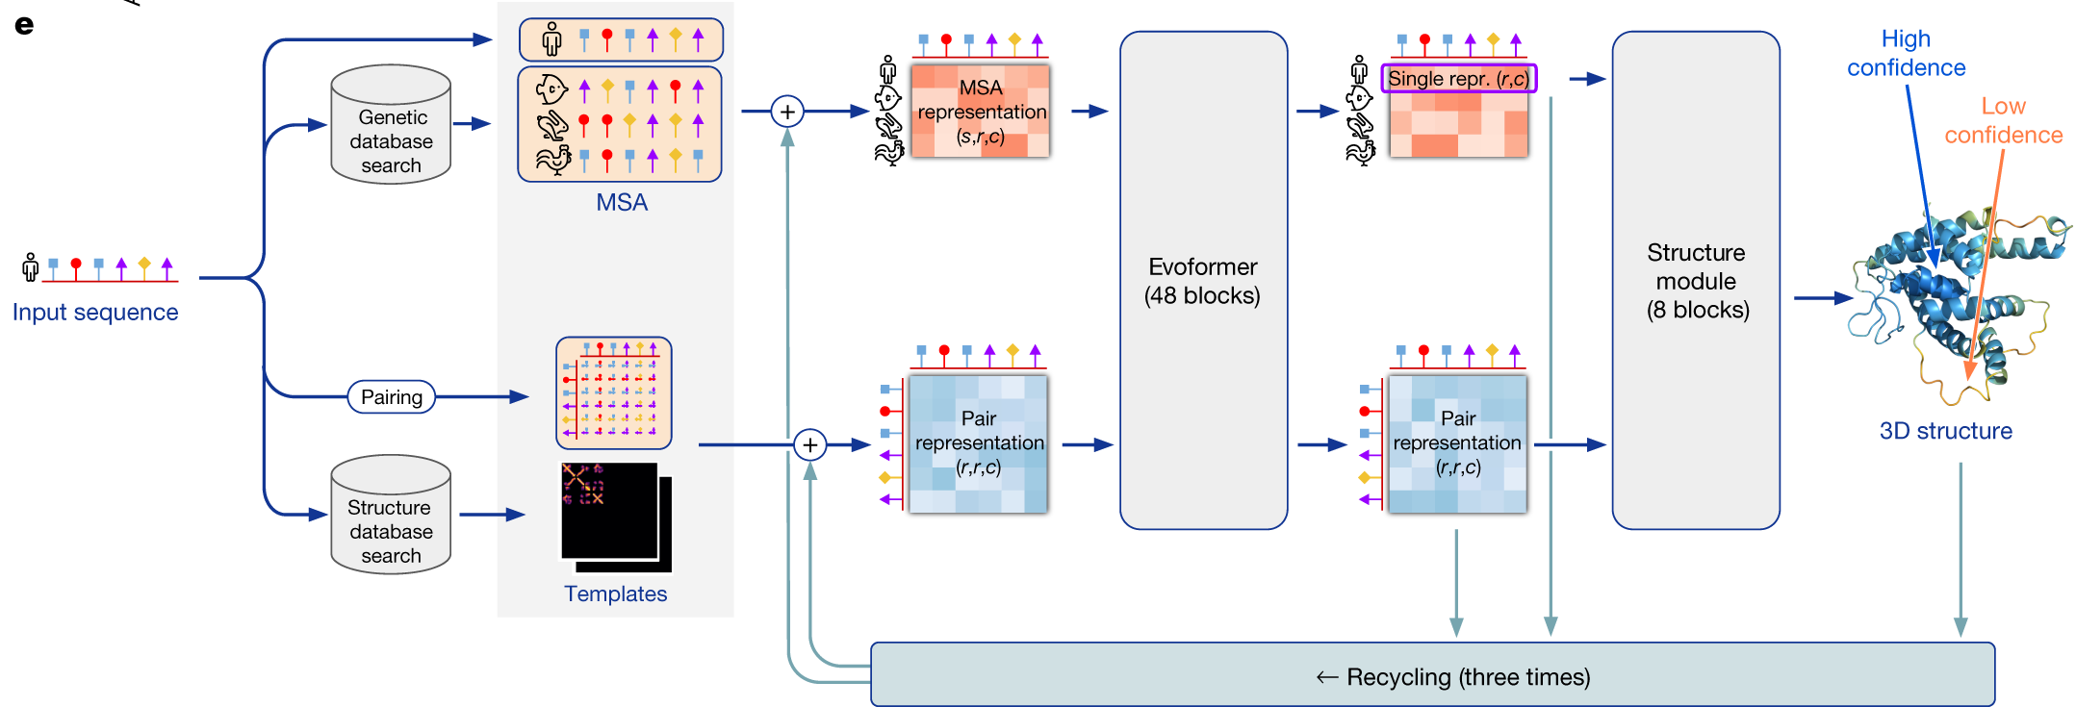
AF2 methodology
AF2 makes an MSA. It learns the best way to extract covariance information from this itself
It also looks for templates, just like homology modelling!
AF2 has a MSA track (above) and a pair track. The ‘Evoformer’ (two transformers, trained on the whole PDB) is part of a huge neural network to extract distance information. Recycling incorporates initial structure predictions to better predict distance information
The structure block produces coordinates – adding side chains, accuracy estimates and a Predicted Alignment Error (PAE)
Jumper et al. (2021) Nature 27. 1666
Notes:
We assume AF2 uses covariance to infer distances but we don’t know – DEEP learning . Terwilliger

Slide 6
>target_seq (s)
GYYELYRRSTIGNSLVDALDTLISDG
RIEASLAMRVLETFDKVVAETLKDNT
QSKLTVKGNLDTYGFCDDVWTFIVKN
CQVTVEDQSVISVDKLRIVACNSKKS
Applications…
Multiple Sequence Alignment
of homologous sequences
...KDNTQSKLTVKGNLDTYGFC...
...KDNTQSKLTVKGNLDTYGFC...
...KNDANIAKLKLTFKGDLDTY...
...RENTQSKLNVKGLLDTYGFC...
...KNENIVGKSKLIFKGDLDTY...
...KNESNIAKSKLTFKGDLDTY...
...KHESNIAKSKLTFKGDLDTY...
...KNESGISKSKLTFKGDLHTY...
...KDNTQSKLTVKGLLDTYGFC...
...KSESGIAKSKLTFKGDLHTY...
Evolutionary covariance
Direct Coupling Analysis of
large MSAs plus Deep Learning predicts contacts or distances
...KDNTQSKLTVKGNLDTYGFC...
...KDNTQSKLTVKGNLDTYGFC...
...KNDANIAKLKLTFKGDLDTY...
...RENTQSKLNVKGLLDTYGFC...
...KNENIVGKSKLIFKGDLDTY...
...KNESNIAKSKL FKGDLDTY...
...KHESNIAKSKL FKGDLDTY...
...KNESGISKSKL FKGDLHTY...
...KDNTQSKLTVK LLDTYGFC...
...KSESGIAKSKL FKGDLHTY...

Slide 7
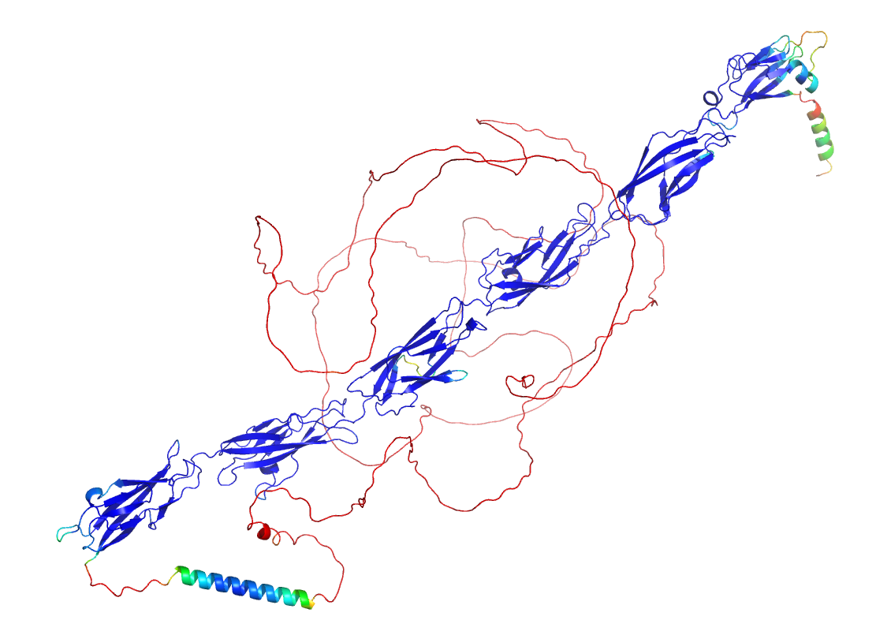
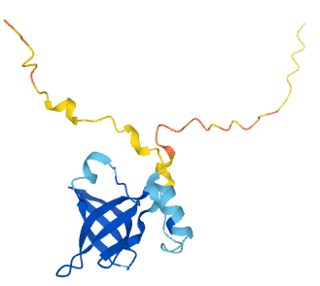
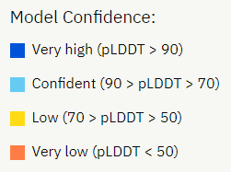
pLDDT is a measure of predicted local quality
Notes:
Loops often lower confidence

Slide 8
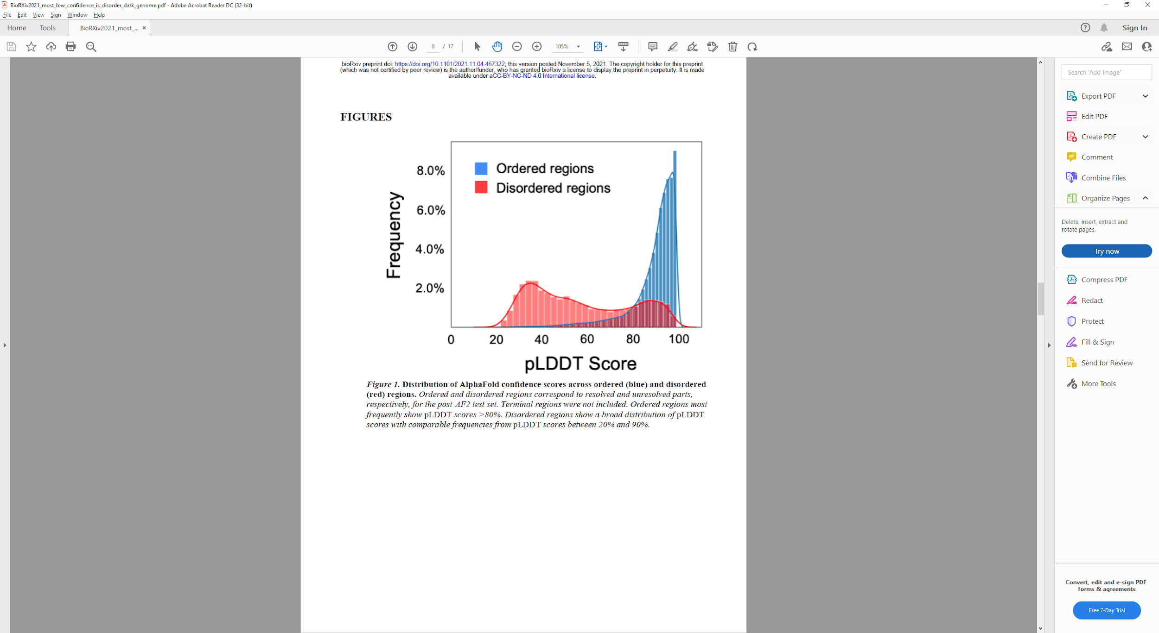
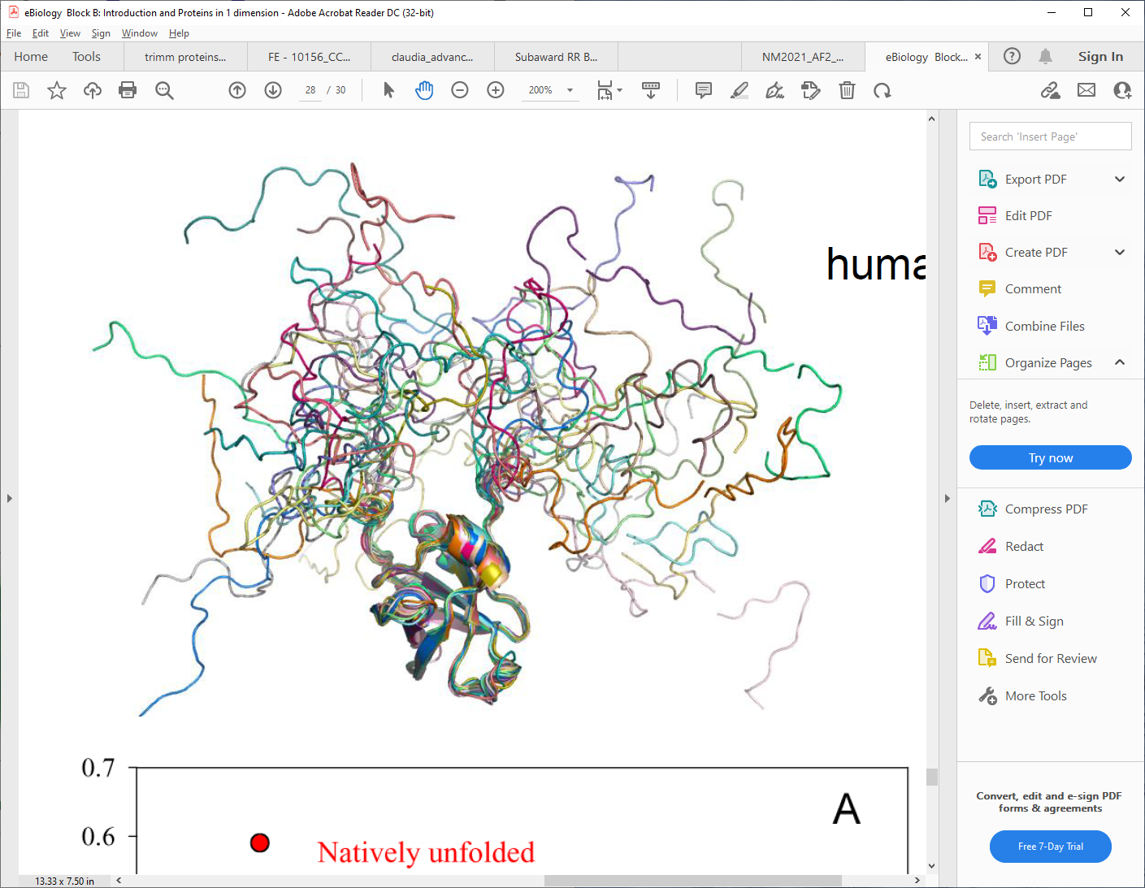
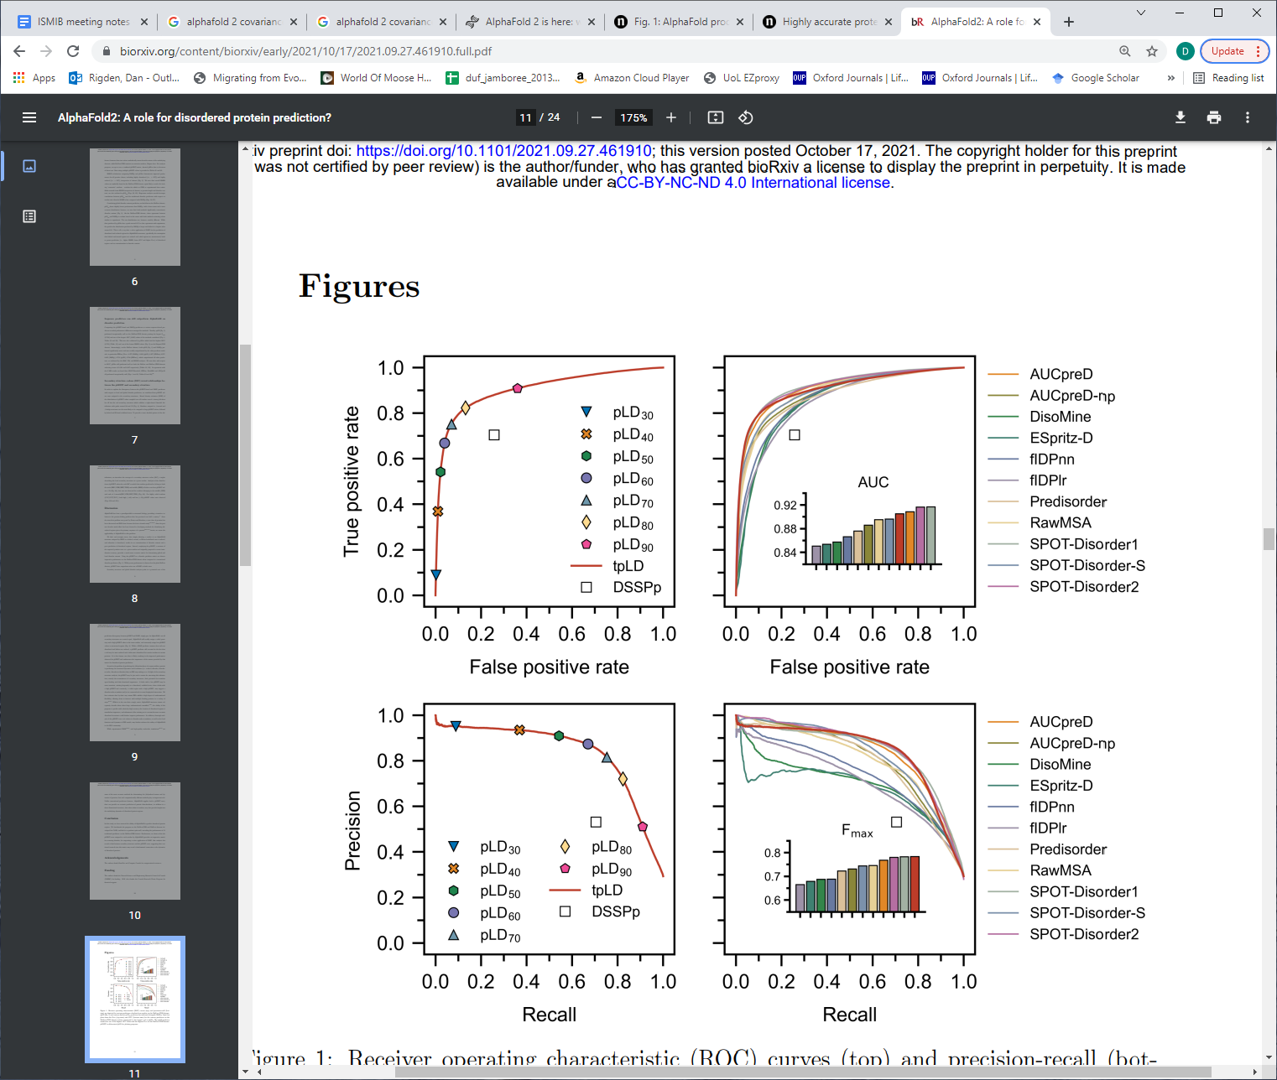
Many low confidence (low-pLDDT) regions are intrinsically disordered
Binder et al. (2022) COSB 74, 102372
Predicting intrinsic disorder from low pLDDT regions in AF2 models is competitive with the best sequence-based predictors
Wilson et al. (2021) IJMS 23, 4591
Notes:
Interesting example of using AF2 for something it wasn’t dsigned for. Not the last time you’ll see tat!

Slide 9
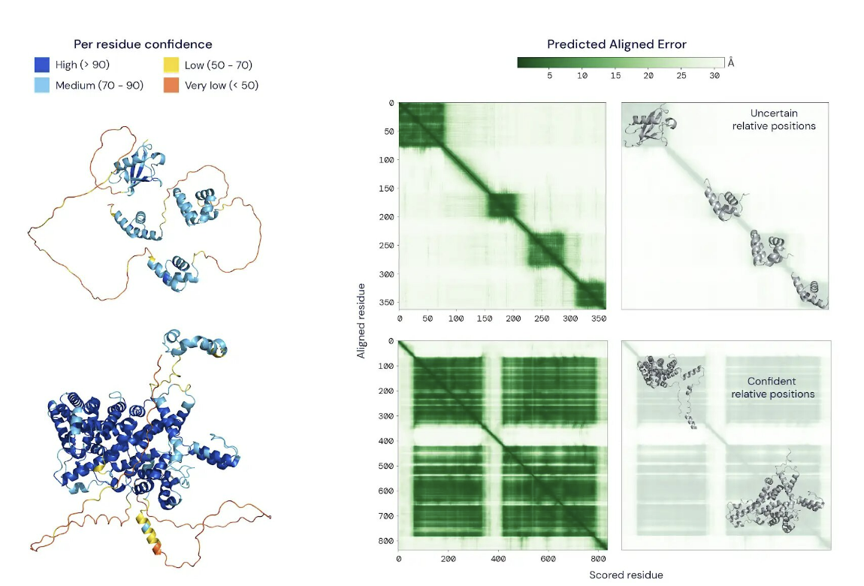
The Predicted Aligned Error (PAE)
https://www.deepmind.com/publications/enabling-high-accuracy-protein-structure-prediction-at-the-proteome-scale
Notes:
Third AF2 output, not output by some competitors

Slide 10
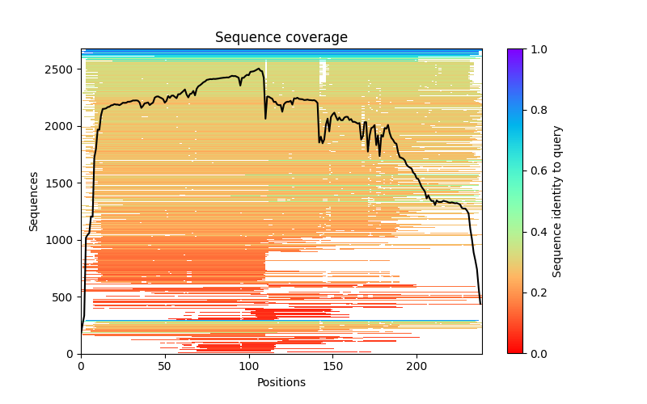
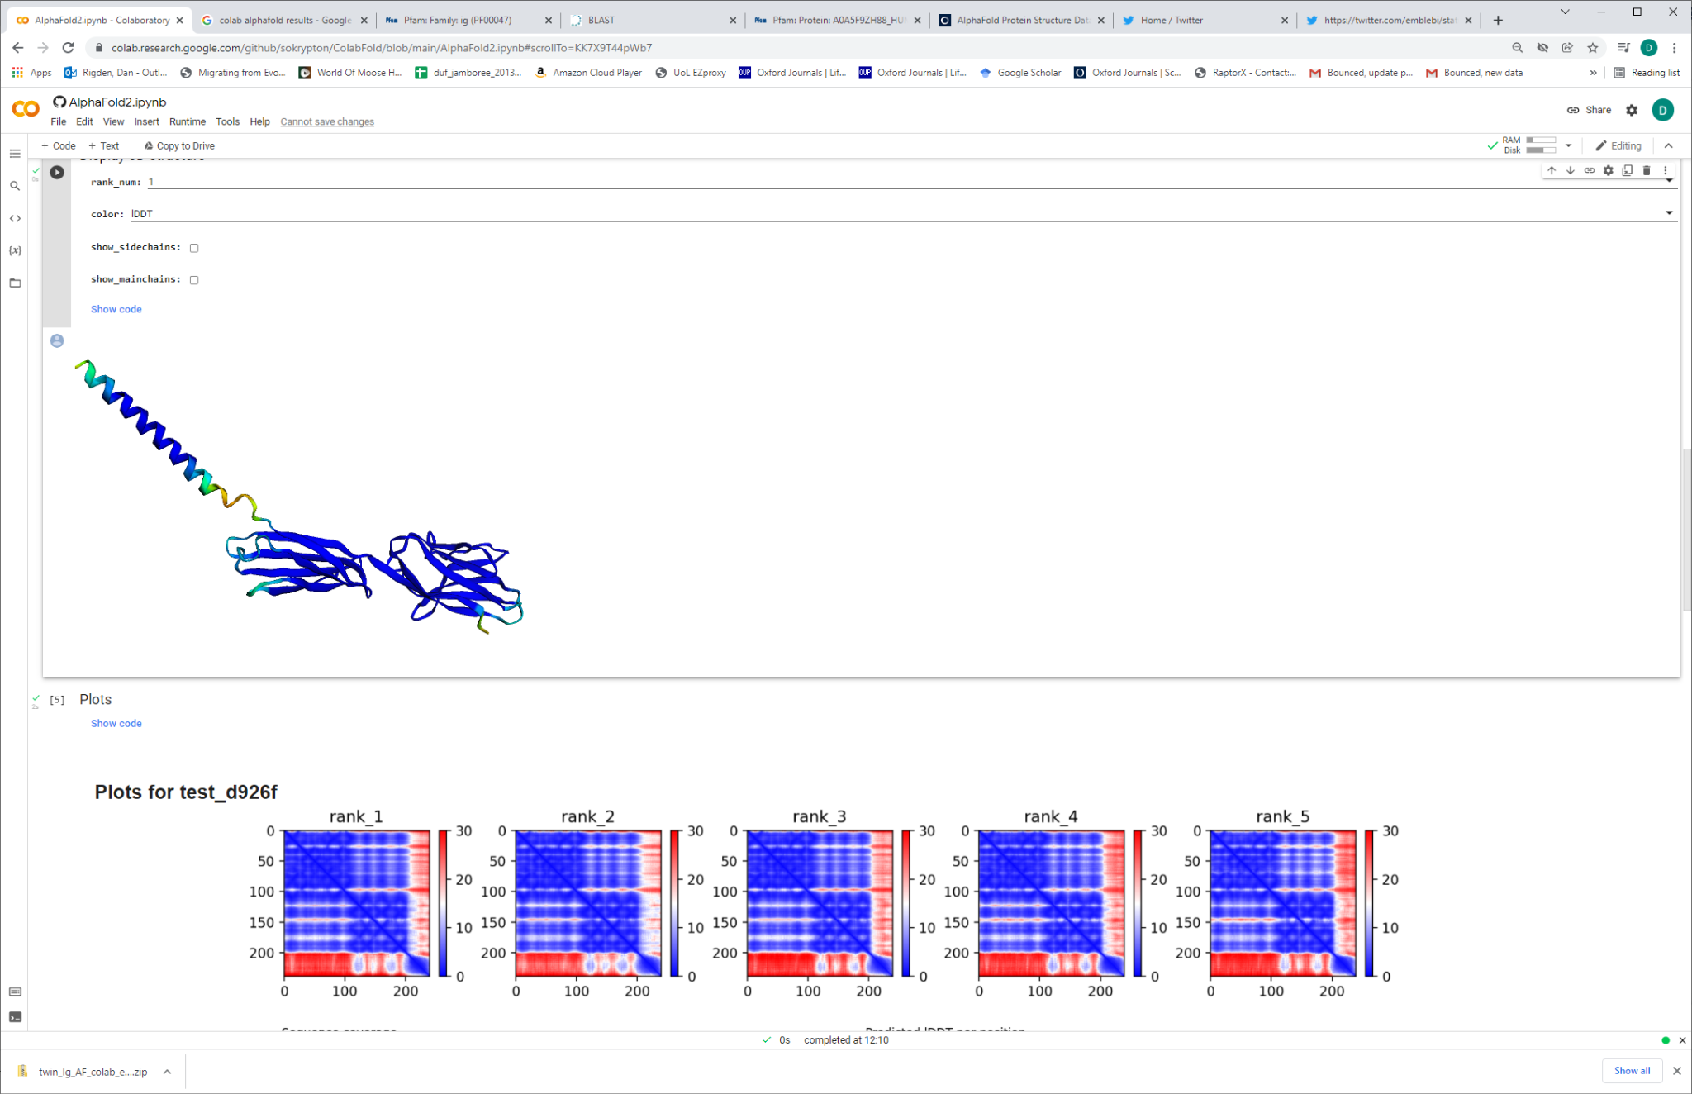
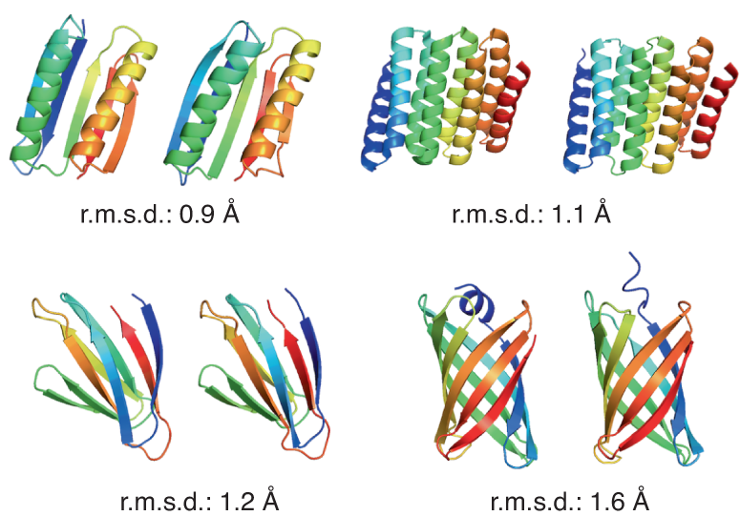
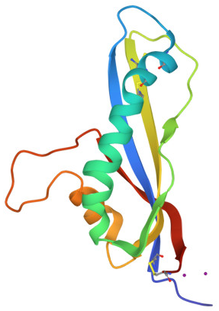
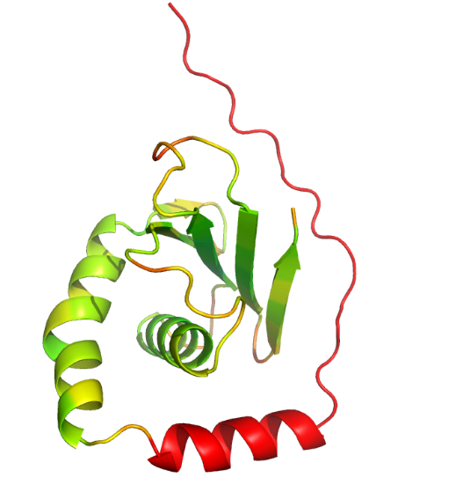
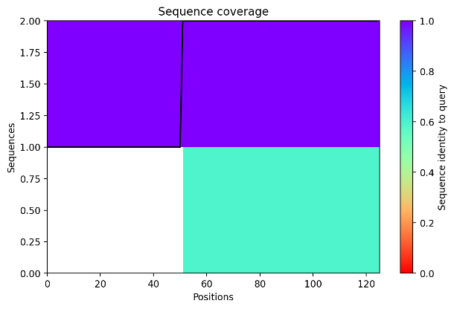
AF2 is still dependent on evolutionary covariance for natural proteins
Often have good covariance from deep alignment, hence good model
AF2/RF can produce good models of artificial proteins (no homologues!)
But natural proteins with few homologues are not modelled well
Baek & Baker et al. (2021) Nature Methods 19. 13
7b76

Slide 11
Databases and searching them

Slide 12
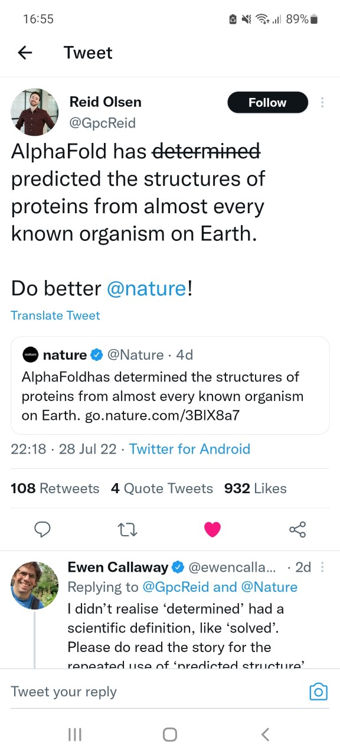
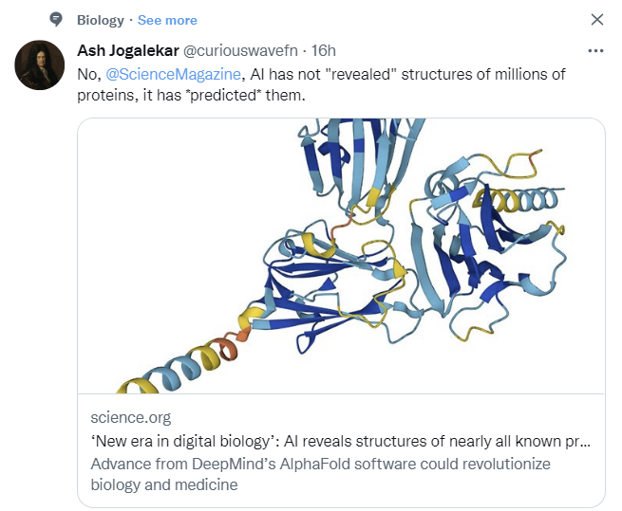
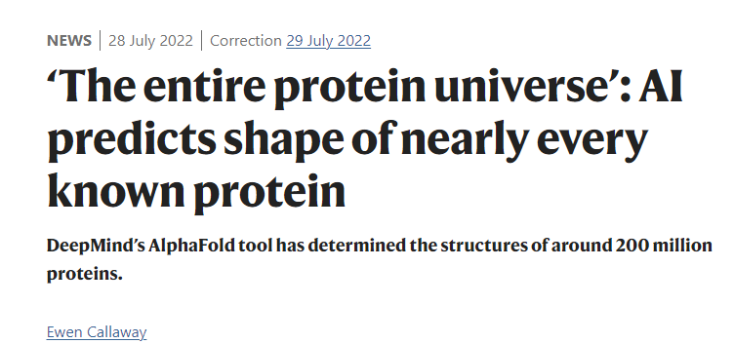
EMBL-EBI AlphaFold Protein Structure Database
v1 July 2021 with 21 proteomes ~350k structures
v2 Dec 2021 + manually curated UniProt (old SwissProt) >400k
v3 July 2022 >90% of UniProt (not viruses) >200M
Sequence search https://www.ebi.ac.uk/Tools/sss/
Varadi et al (2022) NAR 50, D1, 439

Slide 13
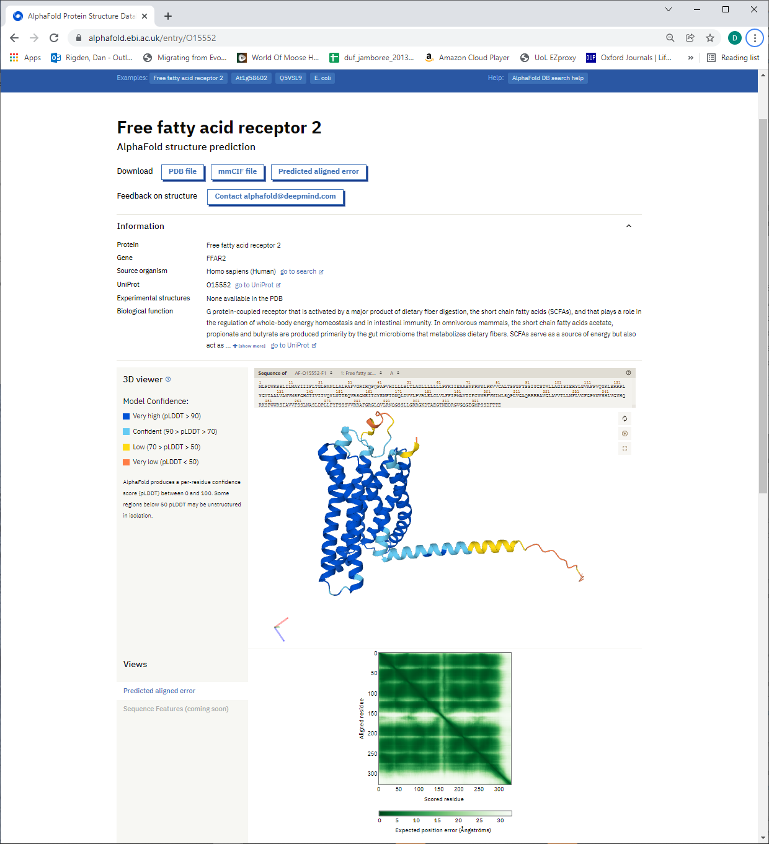
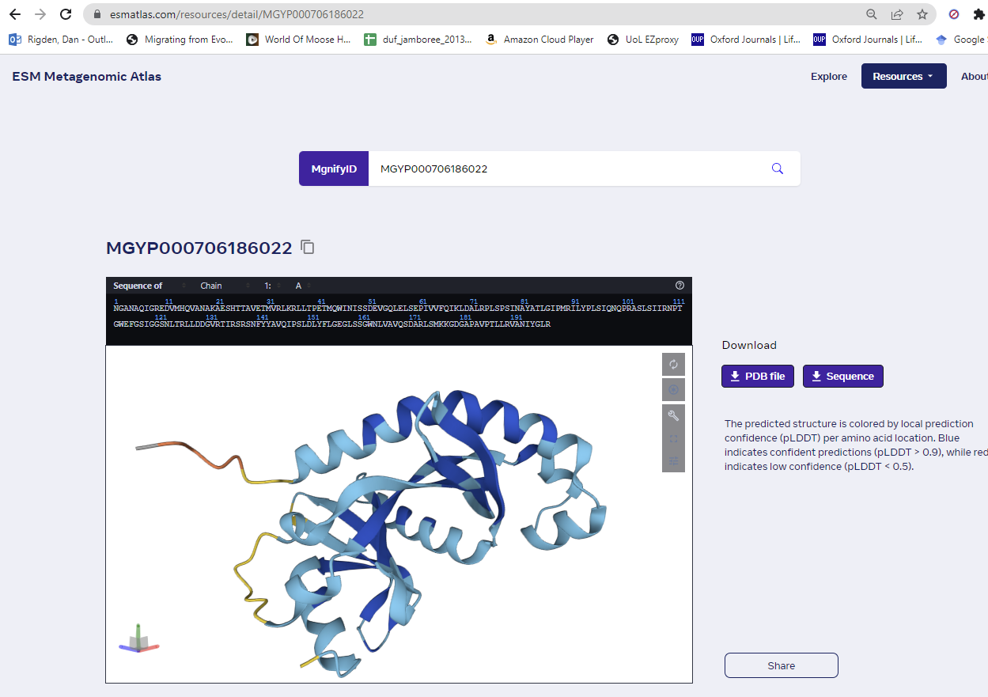
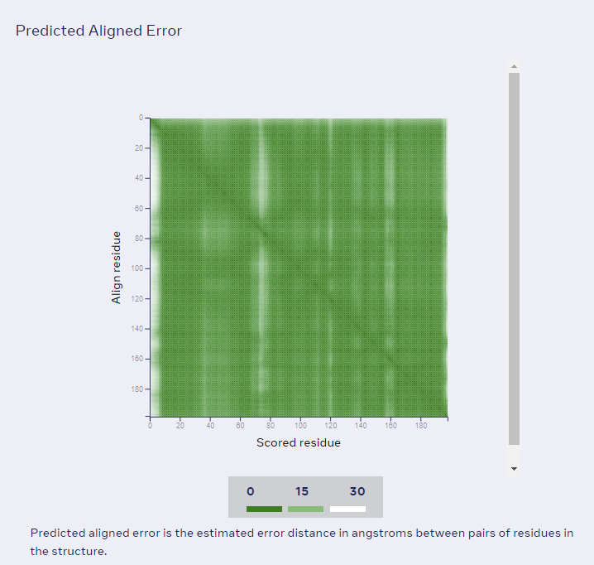
AFDB
ESM Metagenomic Atlas

Slide 14
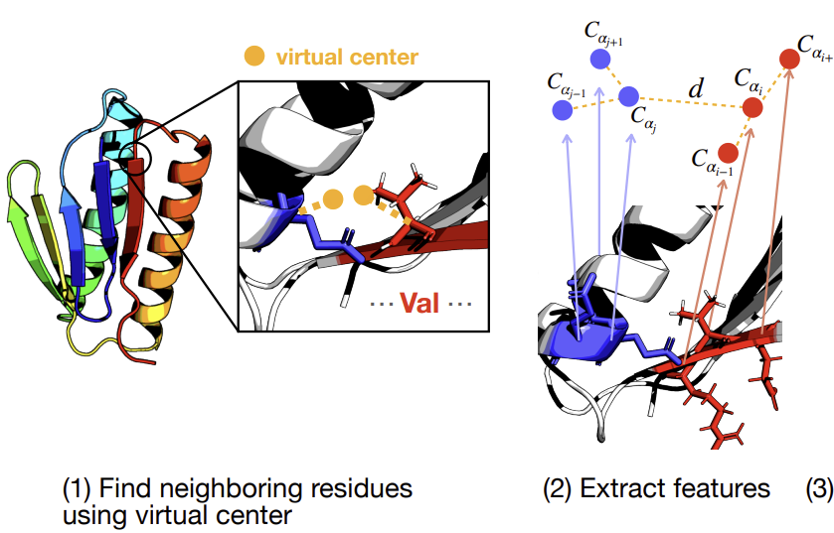
FoldSeek to search AFDB etc
Almost as sensitive as DALI
Very fast
Scans UniRef50 of v3
Works by representing structural neighbourhoods as strings and string matching
Phylogenetic filtering
“The 20 states of the 3D-interactions (3Di) alphabet describe for each residue i the geometric conformation with its spatially closest residue j.”
https://search.foldseek.com/
van Kempen et al (2023) Nature Biotech https://doi.org/10.1038/s41587-023-01773-0
Notes:
Local alignment of 3Di alphabet or TMalign

Slide 15
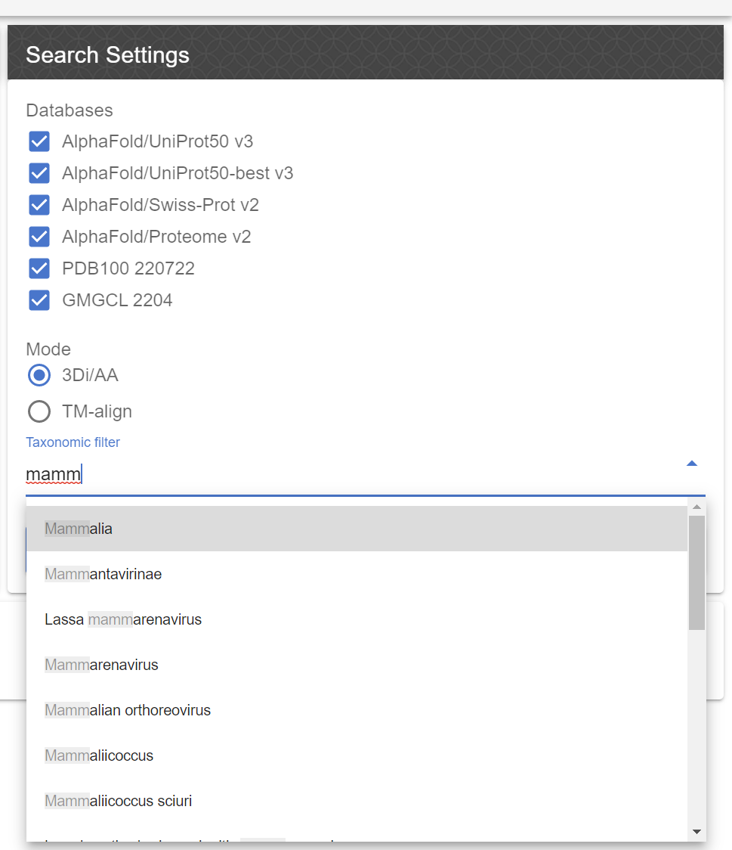
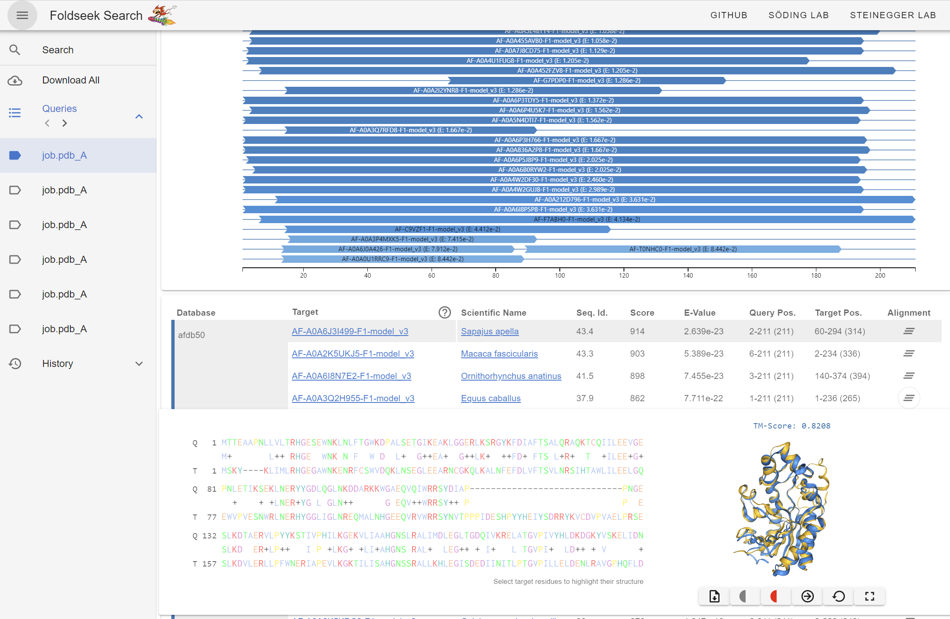
FoldSeek to search AFDB
https://search.foldseek.com/
van Kempen et al (2023) Nature Biotech https://doi.org/10.1038/s41587-023-01773-0
Notes:
Local alignment of 3Di alphabet or TMalign

Slide 16
Why generate your own models
Limitations of AF in general
Models may not include the conformation you want
Multidomain proteins are hard, but remember may not be a single favoured conformation
It’s not aware of membranes, post-translational modifications or ligands
Models of sequence orphans may not be good (but at least it tells you that)
You can’t easily feed in existing knowledge eg disulphides
Limitations of AFDB specifically
Only one isoform
Large proteins split or absent
No oligomers or complexes
Better models may be possible with today’s sequence databases

Slide 17
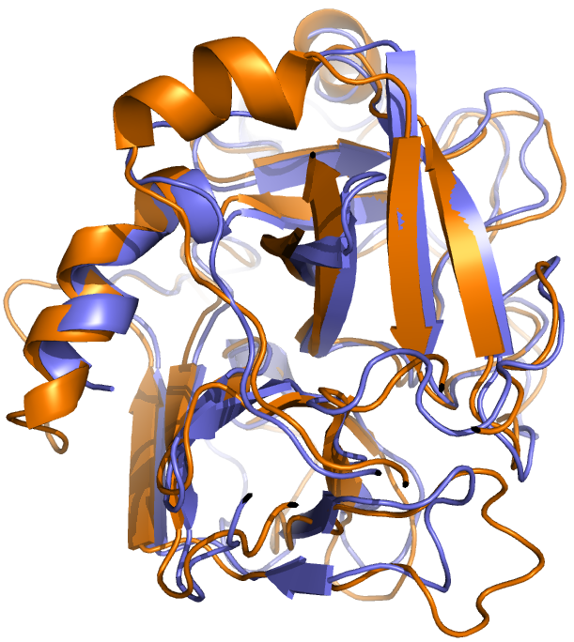
Structure databases inform on protein function
Homologous proteins may share the same function
Matching structures is more powerful than matching sequences since sequences mutate faster than structures
Structure matching finds homologies that inform about function that are not visible by sequence analysis
Trypsin vs factor X (31% sequence identity)

Slide 18
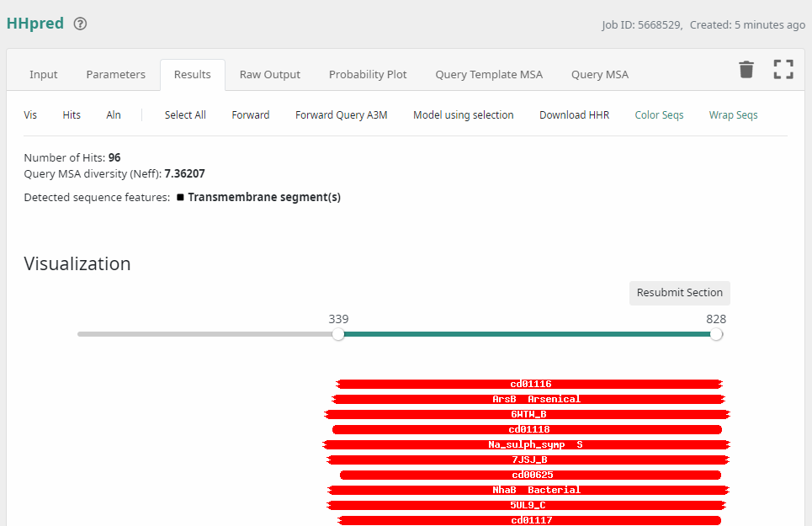
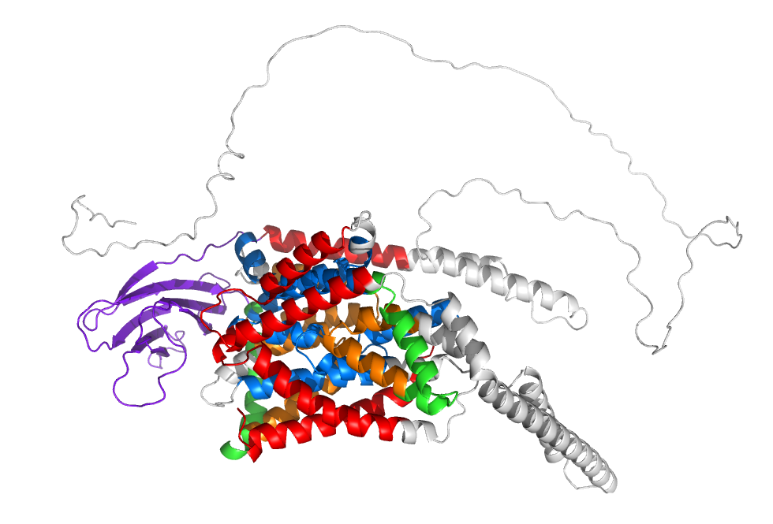
Structure databases inform on protein function
Homologous proteins may share the same function
Matching structures is more powerful than matching sequences since sequences mutate faster than structures
Structure matching finds homologies that inform about function that are not visible by sequence analysis
Nothing visible at sequence level for N-terminal region of Oca2, but clear domain in AF2 model!
New domain looks like a GOLD domain. Matches Golgi localisation known for the Oca2 protein
Mesdaghi et al. (2023) BioSci Rep 43:BSR20230060

Slide 19
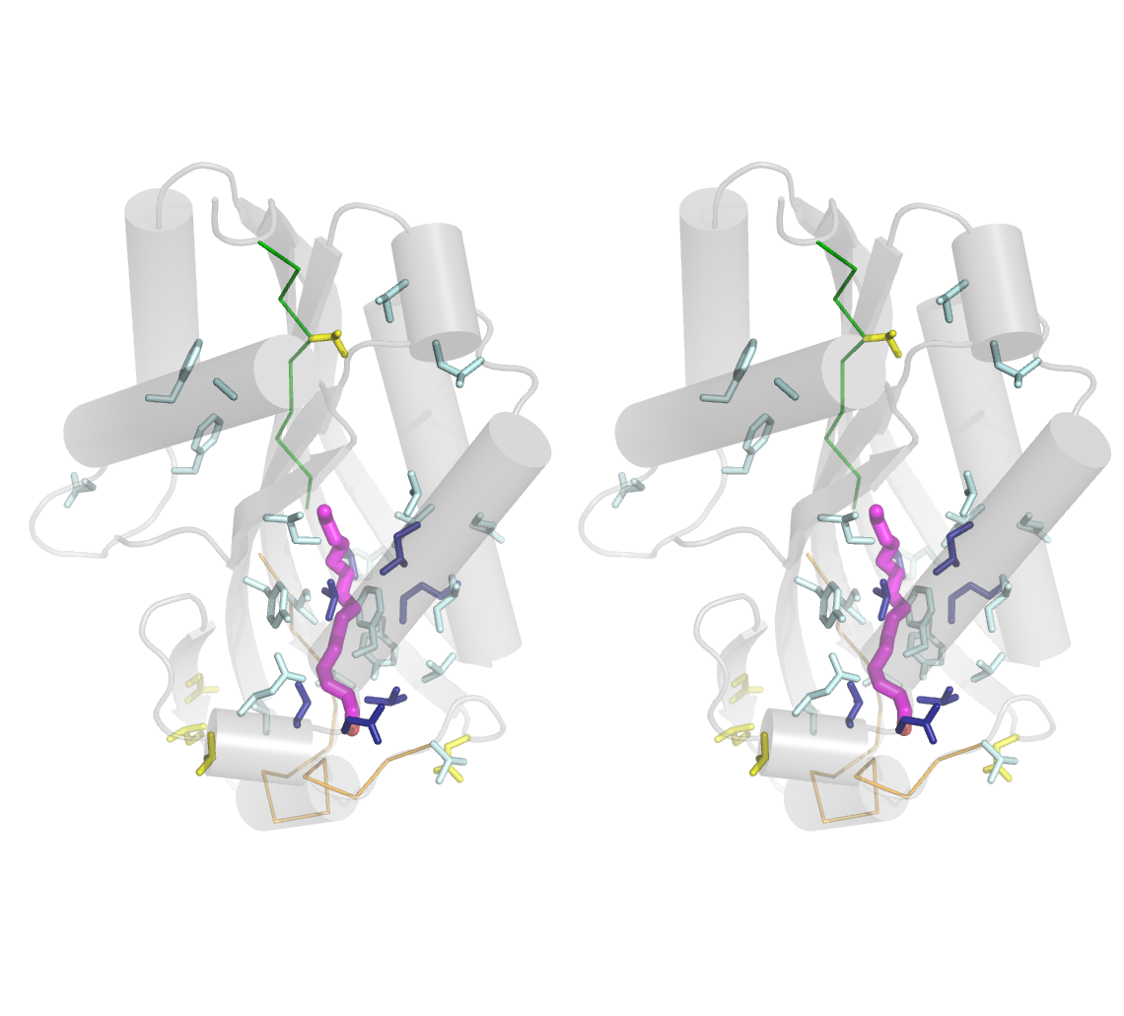
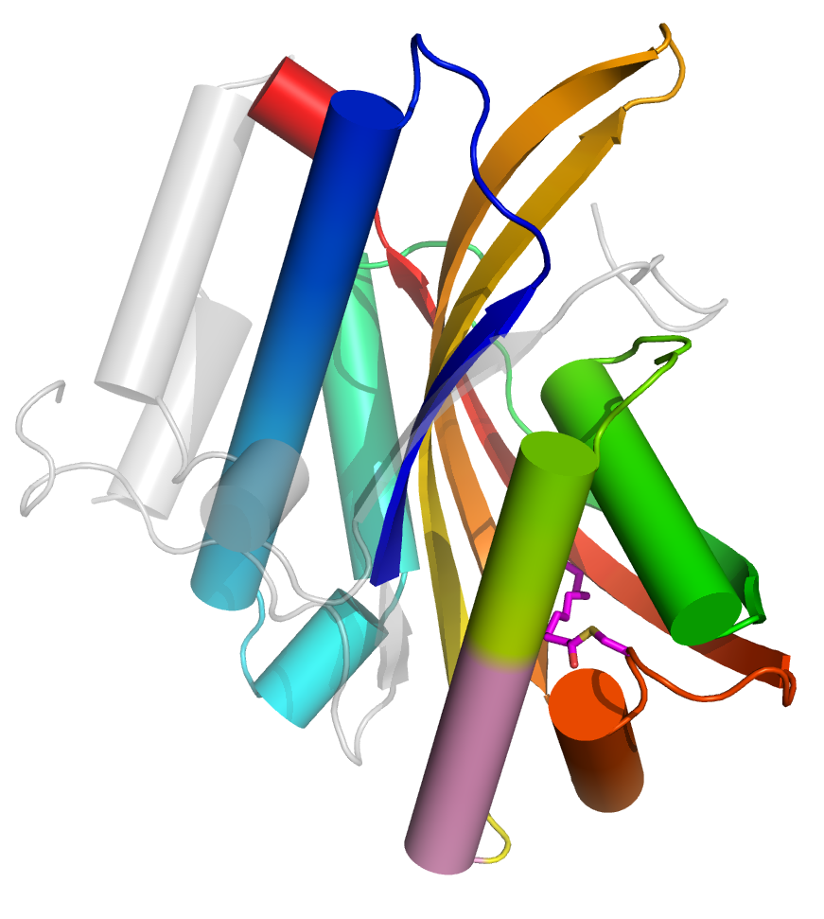
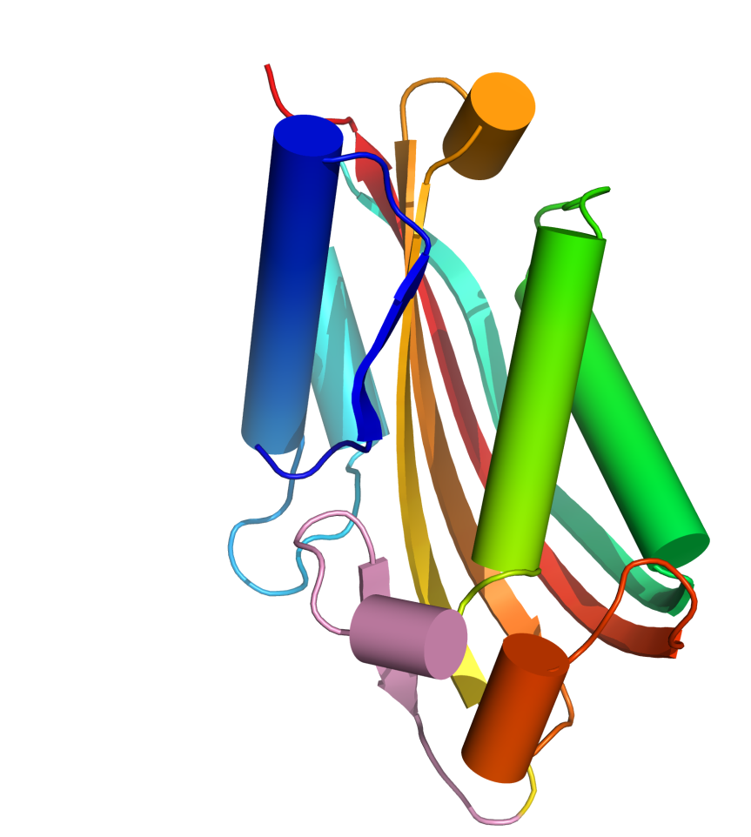
Multiple methods in bioinformatics: Structure comparisons of Evf
Reported as novel fold...
... but in fact related to Bacillus toxin structures (DALI)
Both bind to host insect membranes
Palmitate seen in Evf structure. Matches conserved region of toxins...
DALI is the gold standard….
… but FoldSeek is great for a quick search of the AFDB, ESMAtlas etc
Quevillon-Cheruel et al. (2009) J. Biol. Chem. 35,2107
Rigden (2009) FEBS Lett. 583, 1555

Slide 20
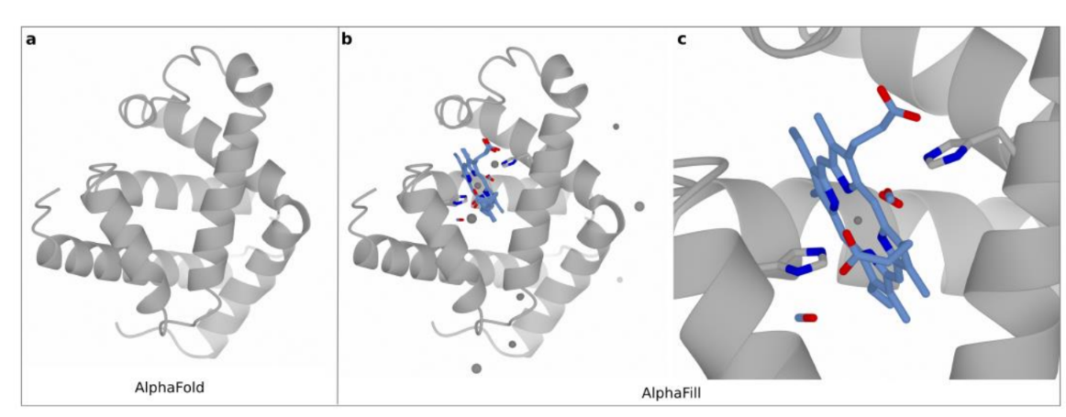
AlphaFill AF2 and ligands
AFDB models BLASTed against PDB-REDO
Where a ligand of interest (or an analogue) is found in a reasonably close homologue (eg >70% sequence identity), it is transplanted into the AFDB model using a local structural alignment of binding residues
Hekkelman et al (2022) Nature Methods https://doi.org/10.1038/s41592-022-01685-y
https://alphafill.eu/
Notes:
Human myoglobin

Slide 21
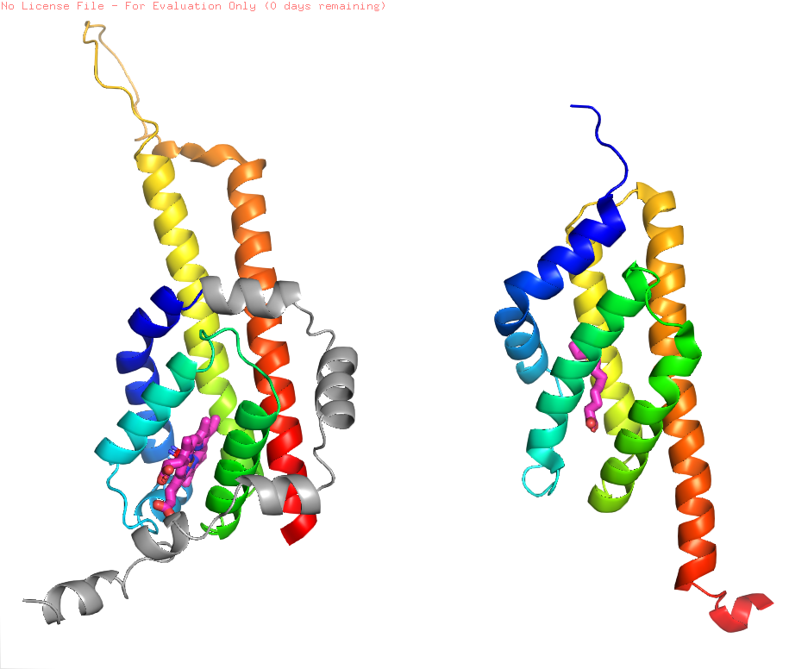
What does my microbial globin bind?
Fold in itself is not very helpful here since the globin domain (like many others) is associated with different functions
AlphaFill spots that the binding site of one is compatible with haem, while the other may bind fatty acid

Slide 22
Structure → Function methods

Slide 23
Functional sites from structure
General principle is to spot ways in which in which functional sites differ from protein surface in general
Functional sites in general
Are typically conserved in sequence through evolution
Binding sites for ligands
Are often largest pockets, cavities of clefts on protein surface
May have unusual electrostatic properties
May have other specific preferences according to ligand eg carbohydrate
Catalytic sites
May evolve independently
May be revealed by spotting residues with unusual pKa values
Notes:
Key idea is to understand the characteristics of these sites so that predictions can be made about new ones

Slide 24
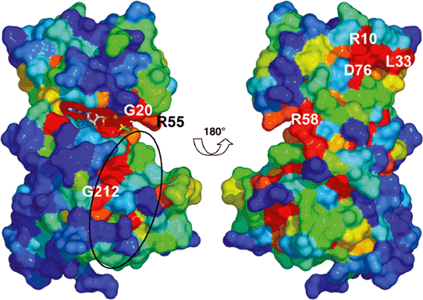
Functional sites are better conserved than the rest of the protein
Site of interaction with other proteins
ATP-binding site
Core residues conserved for structural reasons
peptide binding site
PknB protein kinase
Notes:
3 binding sites. Note residues also conserved for structural reasons

Slide 25
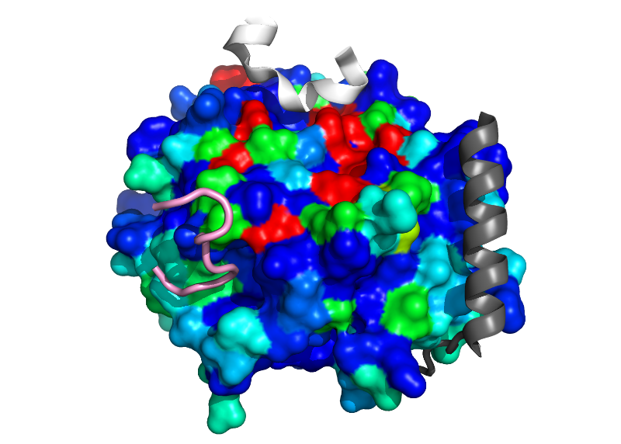
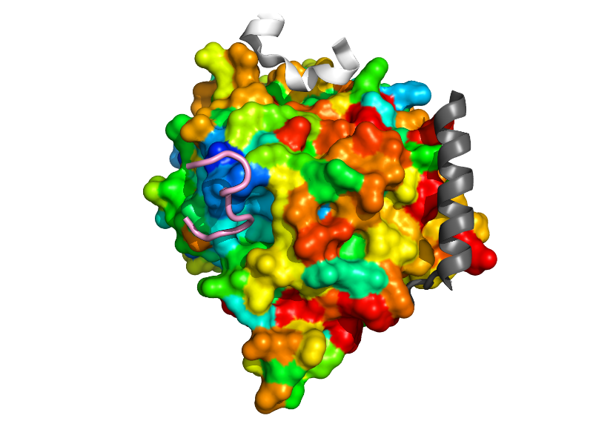
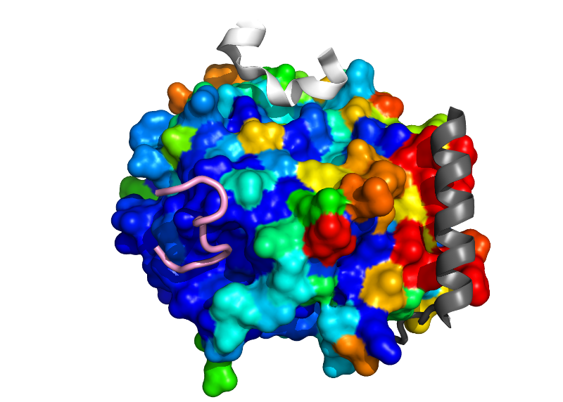
But think about the question you are trying to answer
Mapping 300 homologues mixes different activities so no information on binding sites
Consurf maps sequence conservation onto a structure revealing functional sites
Excellent, general method, but results depend on sequence set chosen for mapping: selecting all or only near relatives gives different results. Either might be more appropriate for you
But restricting to a single protein family shows only ‘pink’ site is functional in both Diptera and Lepidoptera

Slide 26
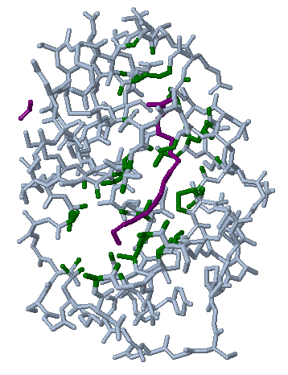
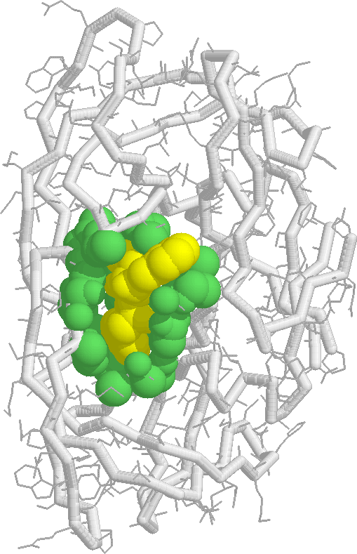
Pockets in protein structures
The largest pocket is frequently the site of binding and/or enzymatic activity. In single chain enzymes, the catalytic site is in the largest cleft in 83% of cases.
CASTp is one program that finds cavities
Lipid-binding protein
HIV protease

Slide 27
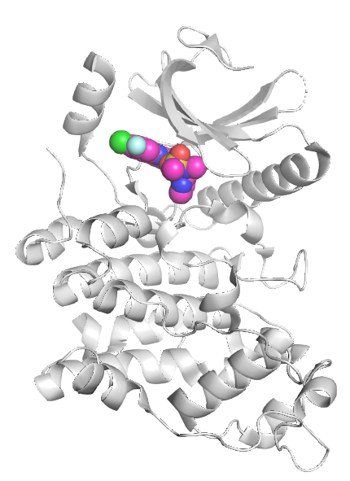
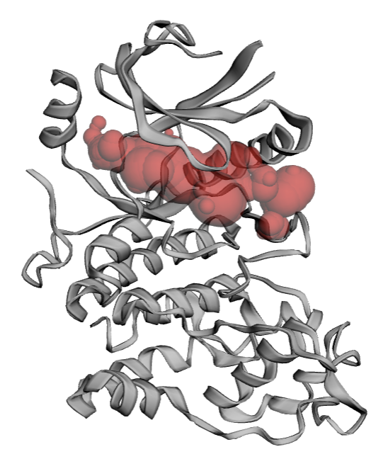
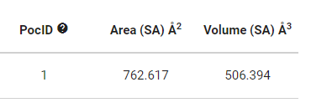
But take care with AF2 models
CastP
Human SRSF protein kinase 2, PDB 7zkx

Slide 28
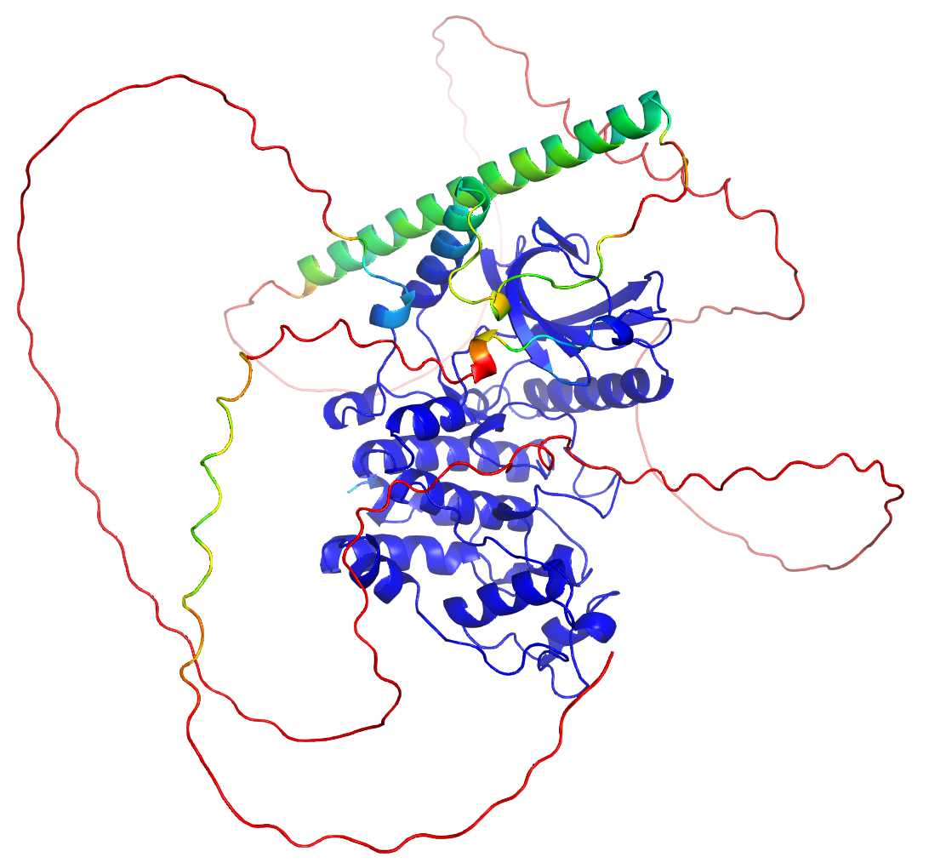
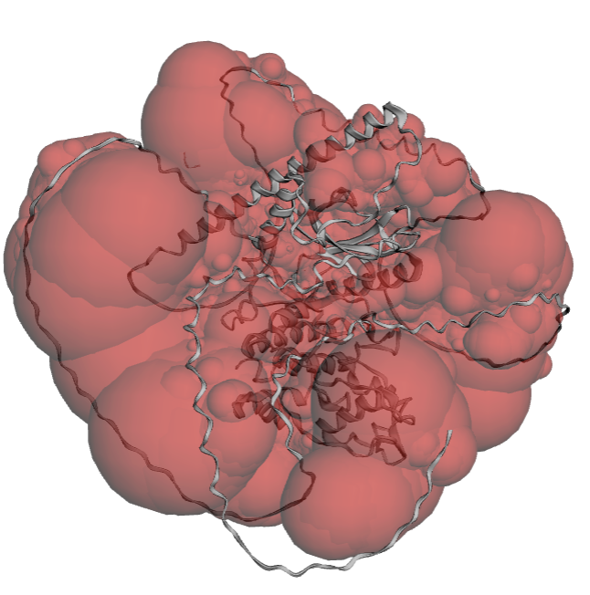
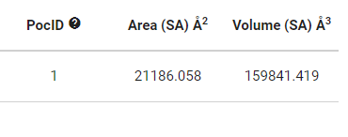
But take care with AF2 models
CastP
Human SRSF protein kinase 2, AFDB AF-P78362-F1

Slide 29
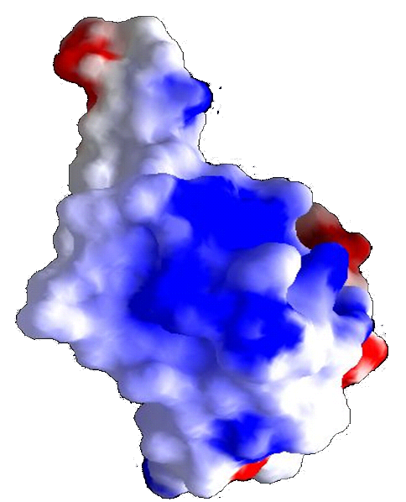
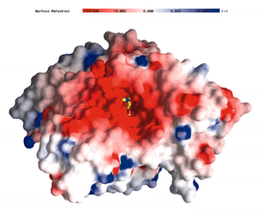
Electrostatic characteristics
Regions of strong positive or negative electrostatic potential are often functionally important.
Binding site of the enzyme acetylcholinesterase.
Positively-charged substrate – negatively-charged site
DNA-binding surface of E2 DNA-binding protein.
Negatively-charged ligand – positively-charged site
Notes:
If have lots of acidic residues on surface will become negatively charged. Suited to binding to positive ligands

Slide 30
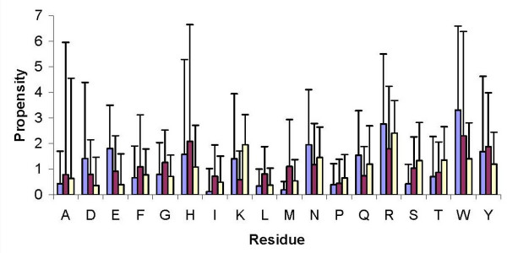
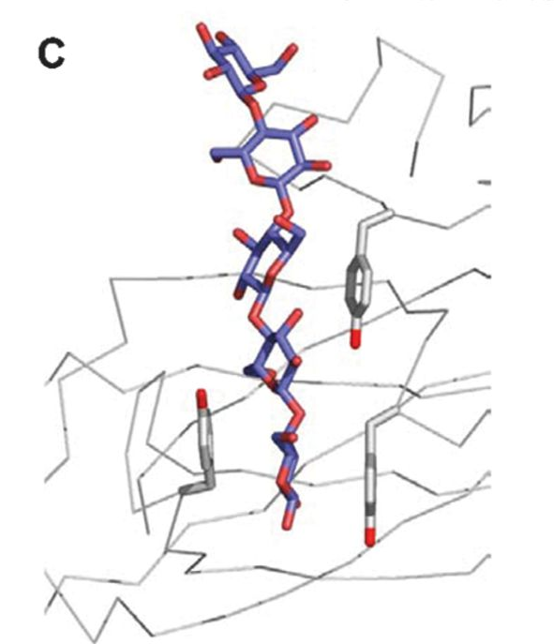
Carbohydrate-binding sites
Common residues can make either hydrophobic interactions of H-bonds with bound carbohydrate
Exposed planes of aromatic residues are particularly characteristic since they interact very favourably with the hydrophobic flat surfaces of carbohydrate rings
Carbohydrate-binding; any ligand-binding; DNA-binding
Malik and Ahmad (2007) BMC Struct. Biol. 7:1
Boraston et al. (2004) Biochem. J. 382:769

Slide 31
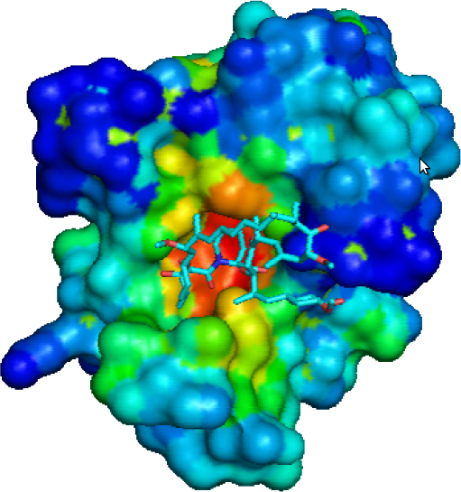
Binding sites from statistics
STP (surface triplet propensities)
13 atom types → 455 triplets
Distribution in binding vs non-binding sites varies
Designed for small molecules, works on PPIs, including flat surfaces
opus.bch.ed.ac.uk/stp
Notes:
Also an approach based on Ftmap, linking small mol clusters togther but results not great and not available.

Slide 32
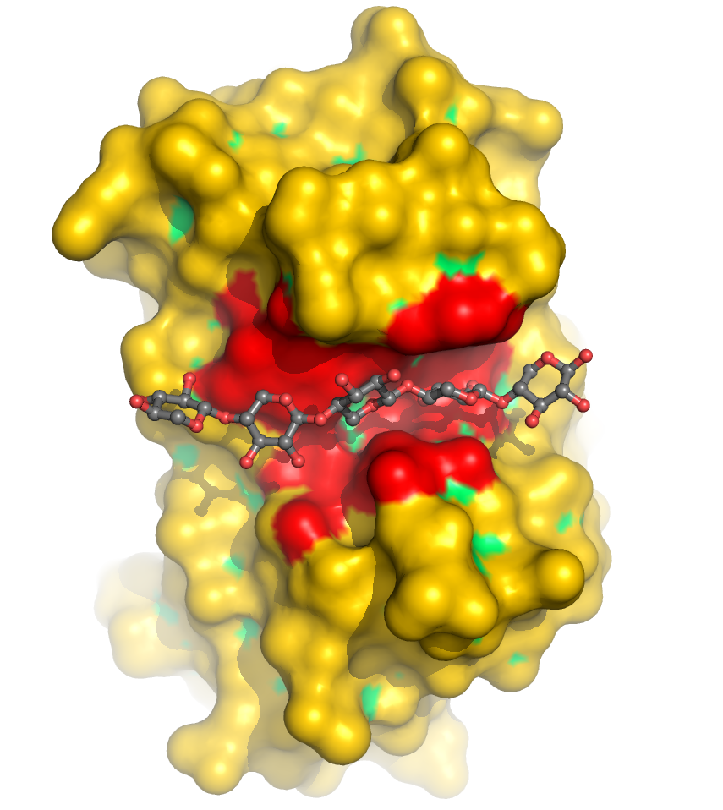
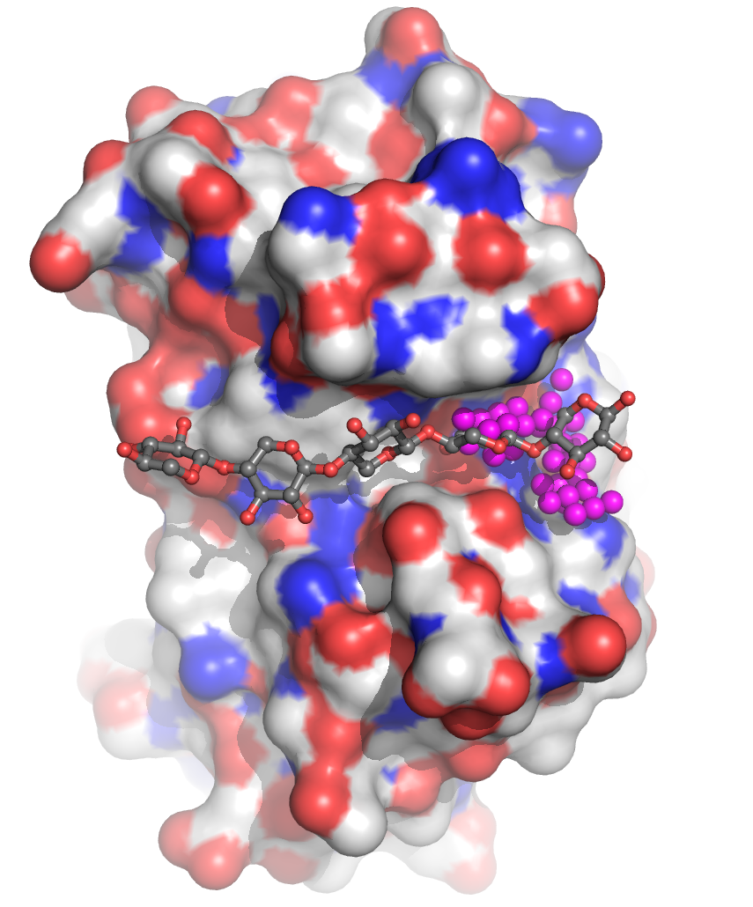
Different probes for different binding sites
Hydroxyl group can be used to probe for carbohydrate binding sites
Phosphate oxygen used for binding sites of phosphorylated ligands
ISMBLab
SiteHound
ismblab.genomics.sinica.edu.tw
sitehound.sanchezlab.org/
Notes:
Complementarity, multiple tools again

Slide 33


Theoretical microscopic titration
pKa of His95 is atypical compared to other His residues in enzyme
Computer analysis of a reliable protein structure can predict pKa values for acids and bases. Residues with perturbed pKa values are possible catalytic residues, especially if clustered.
His95 and other residues with atypical pKa cluster at catalytic site
www.pool.neu.edu/wPOOL/index2.jsp

Slide 34
Case study from Structural Genomics

Slide 35

GxGYxYP proteins
Named for a conserved sequence motif. Molecular function unknown
Over-represented in gut bacteria
Found in Polysaccharide Utilization Loci in Bacteroides thetaiotaomicron
These loci are an example of the gene neighbourhood means of deriving functional linkages
Q: What does the protein do?
Notes:
Most single domain

Slide 36

String.org database
Gene neighbourhood
Co-expression
Co-occurence
etc

Slide 37

GxGYxYP proteins
Domain architectures also predict carbohydrate connection
You have looked at domains previously in Life721!
Notes:
Most single domain

Slide 38

GxGYxYP proteins
Overall folds don’t help much
TIM barrel + 3 x novel α+β unit
TIM barrel DALI Z >13 for
Allantoinase
Polysaccharide deacetylase
Glycosyltransferase
Notes:
NO sharing of key catalytci res w/ other TIM bareels

Slide 39

GxGYxYP proteins
Largest cavity lies between domains
Glycerol from crystallisation solution in it
Notes:
13 atom types → 455 triplets

Slide 40


GxGYxYP proteins
Largest cavity lies between domains
Glycerol from crystallisation solution in it
Picked out by non-geometry based STP (surface triplet propensities)
Notes:
13 atom types → 455 triplets

Slide 41

GxGYxYP proteins
The patch is conserved
Contains multiple aromatic residues, often surface lying in carbohydrate binding sites…
Notes:
NO sharing of key catalytci res w/ other TIM bareels

Slide 42

GxGYxYP proteins
The patch is conserved
Contains multiple aromatic residues, often surface lying in carbohydrate binding sites…
… and acidic residues resembling known glycosidase site… (SPRITE)
… and with perturbed pKa values (THEMATICS)
cellulase
3sgg
Notes:
NO sharing of key catalytci res w/ other TIM bareels

Slide 43
Multiple methods in bioinformatics GxGYxYP conclusion
GxGYxYP is a novel Glycoside Hydrolase family
Genome context
Domain composition
Cavity
Bound glycerol
STP
Conservation
Match to known GH catalytic site
pKa perturbation
Structure-based methods
Rigden et al. (2014) BMC Bioinformatics 15:196

Slide 44
Conclusions
The unprecedented accuracy of AF2 means its models are (often) almost as good as experimental structures for function annotation
Homology detected by structural similarity is powerful
There is a huge range of structure to function annotation methods to apply, and new Deep Learning ones have emerged (next session)
Some are applicable to moderate quality models, others need high accuracy

